Slide 1
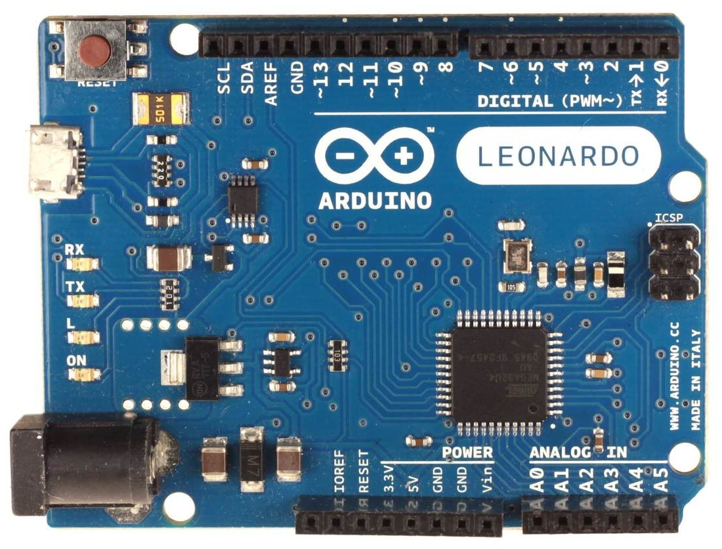
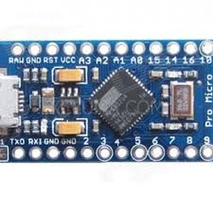
Arduino Leonardo or Micro
Arduino Leonardo FFB wheel fw-v22x pinout:
GND - common ground
5V - Vcc for all devices
A0 - throttle pot
A1 - brake pot (if LC* - then clutch pot)
A2 - clutch pot (if LC* - then handbrake pot, else button8)
A3 - handbrake pot (if LC* - then button0, else button9)
A4, A5 - buttons 1,2 (fw-v220, or XY shifter fw-v220f)
RX - channel A encoder
TX - channel B encoder
2 - channel Z encoder or SDA (data) for i2C ads1015
3 - SCL (clock) for i2C ads1015 (fw-v22xs)
4 - DT pin for HX711 (fw-v222, or button0 in fw-v220)
5 - CLK pin for HX711 (fw-v222, or button7 in fw-v220)
6 - DT_sh (fw-v221, or button4 in fw-v220)
7 - CLK_sh (fw-v221, or button5 in fw-v220)
8 - PL_sh (fw-v221, or button6 in fw-v220)
9 - left PWM channel
10 - right PWM channel
11 - PWM direction pin
12 - button3
13 - FFB clipping LED
x=0, 1, 2, 3
*LC - load cell with HX711 (fw-v222)
To activate buttons
short them to gnd,
unless fw “t” option
Arduino ProMicro
Replacement pinouts for ProMicro:
16 - PWM direction pin
3 - FFB clipping LED, or button3 (fw-v220cm)
14 - button1 (fw-v220m)
15 - button2 (fw-v220m)
2 - button3 (fw-v220m), or
encoder Z-index (fw-v220zm), or
center button (fw-v220cm)
sh - shift register for button box
Hat Switch (fw-v22xh):
Button0 - up
Button1 - right
Button2 - down
Button3 - left

